Slide 1
You Ever Just Think About Brain Tumors?
By Aanchel

Slide 2
“Brain Teaser”
Doing something image based because I wanted to get more practice with preprocessing images
~7k MRIs classified into 4 categories by tumor segmentation (location) and presence of tumor.
Glioma, meningioma, pituitary, and no tumor
Goal is to compare Fully Connected NN, CNNs, and Transfer Learning

Slide 3
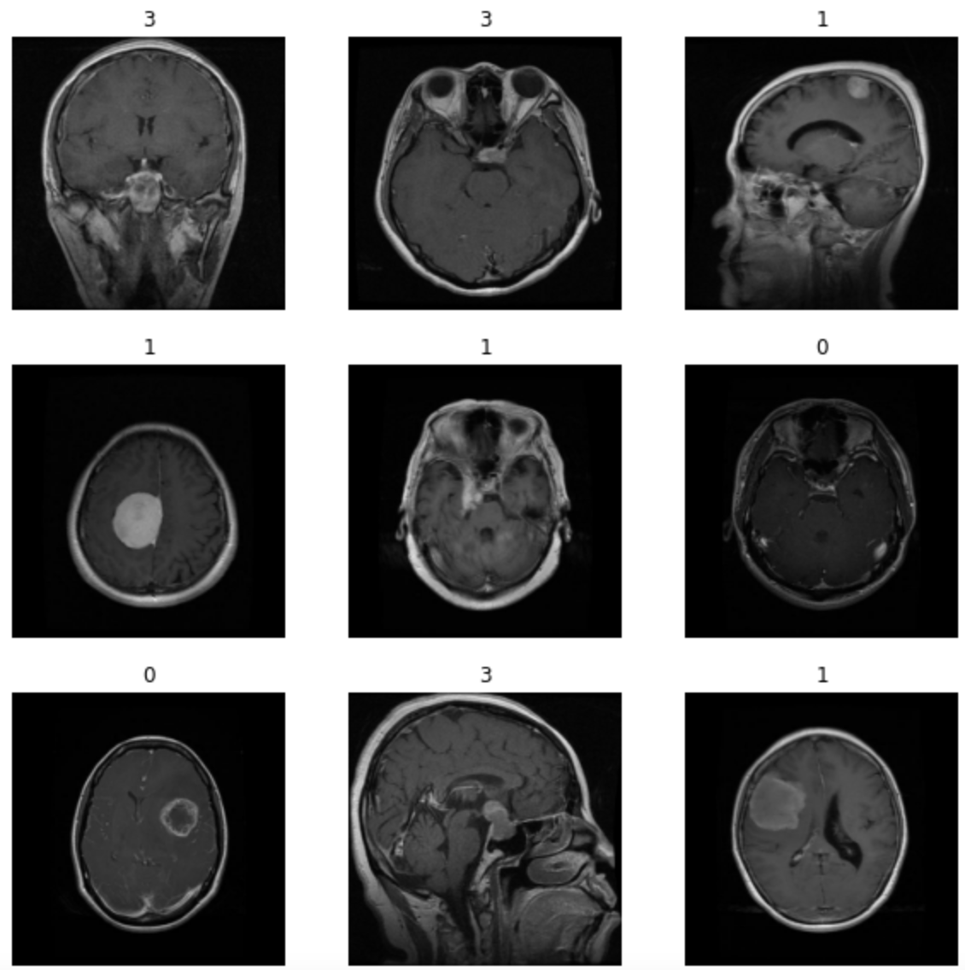
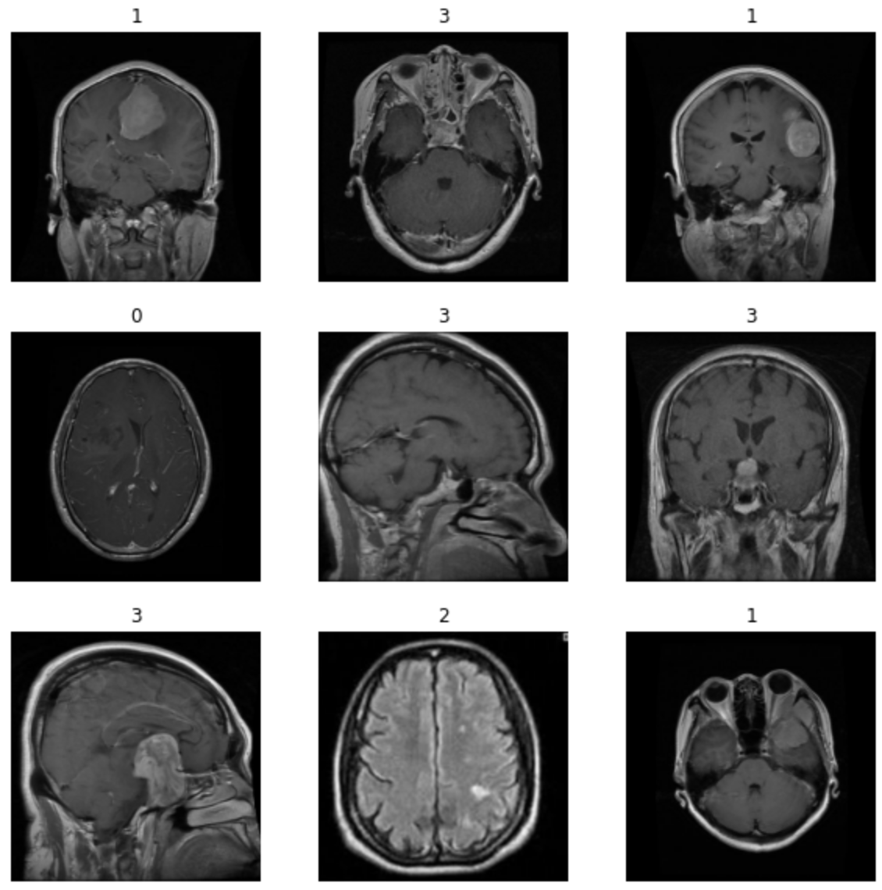
The Dataset
Val

